Slide 1




HackOrbit 2025
Team Adhi

Slide 2

TEAM ADHI
Name : Borigi Jyothiradithya
College : Indian Institute Of Engineering Science and Technology
Department : Computer Science and Technology
Phone Number : 7207180221
E-Mail : adhithyaborigi@gmail.com

Slide 3
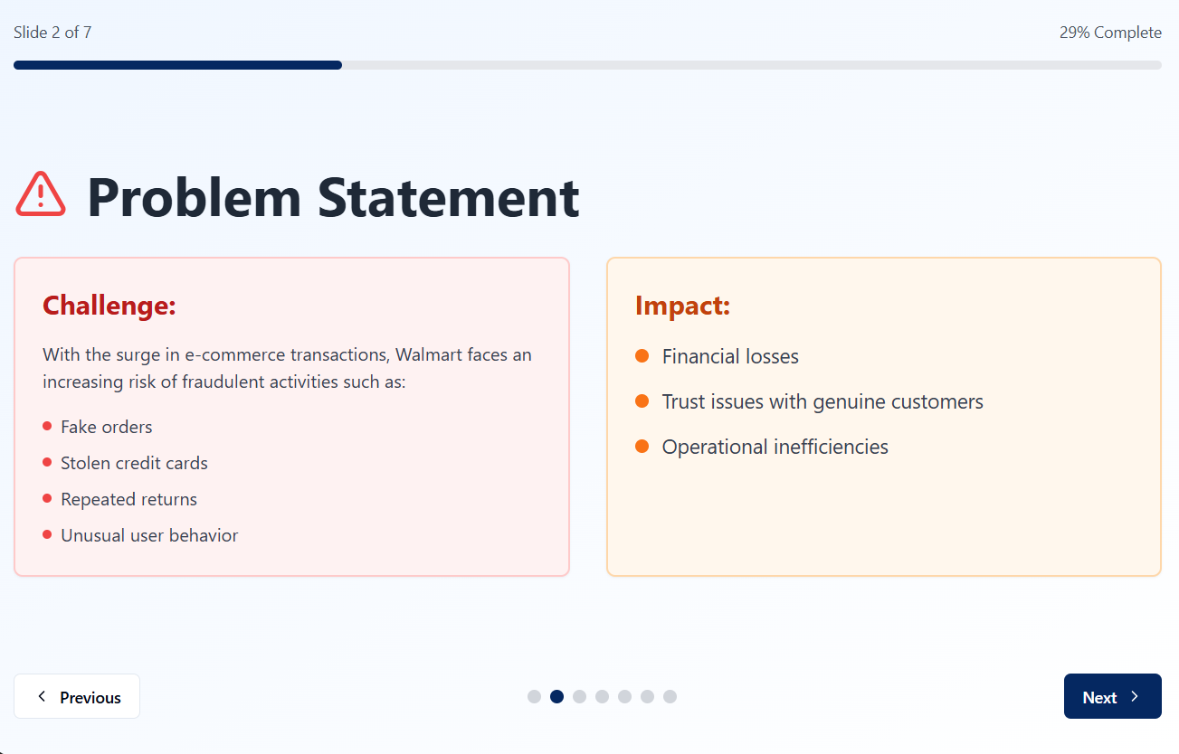
Walmart Fraud Detection System
A Machine Learning Based Real-Time-Fraud Detection Web App
Problem Statement :

Slide 4
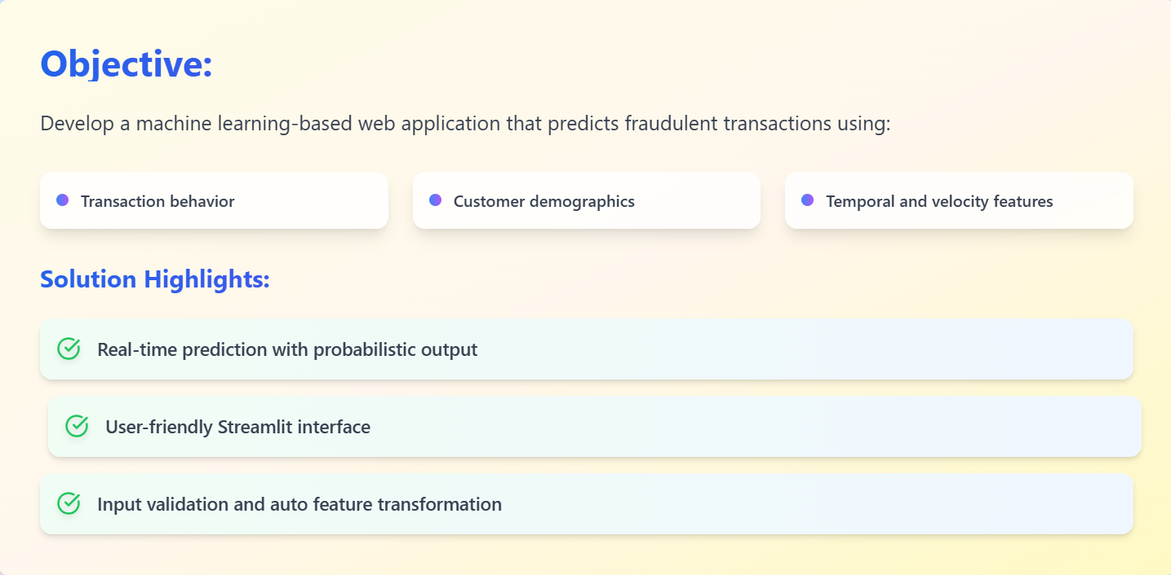
PROPOSED SOLUTION :

Slide 5
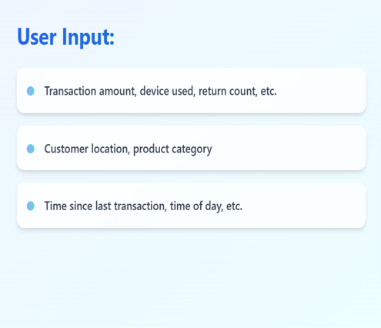
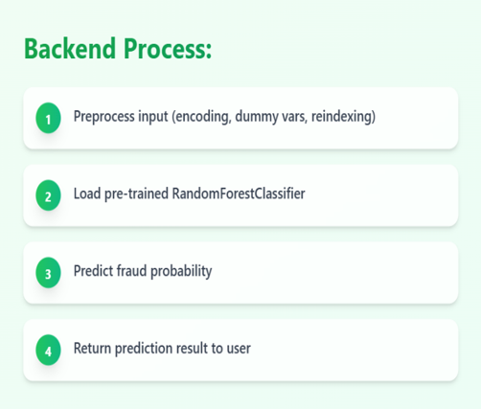
How It Works

Slide 6
Explanation of Working Model
🔹 How the Fraud Detection System Works
Our fraud detection system takes in user transaction details and processes them through a trained machine learning model to identify potentially fraudulent activity. Here's how the system operates step by step:
🧾 User Input
The system gathers key information related to a transaction, including:
Transaction details such as amount, device used, and return count.
Customer attributes like location and product category.
Behavioral patterns such as time since the last transaction and time of day.
These inputs are crucial for identifying patterns that may indicate fraud.
⚙️ Backend Process
Once the user input is received, the backend performs the following steps:
Preprocess the input data – This includes encoding categorical values, generating dummy variables, and reindexing the data to match the model format.
Load the pre-trained model – Specifically, a RandomForestClassifier, which has been trained on historical transaction data.
Predict fraud probability – The model analyzes the input to determine the likelihood of the transaction being fraudulent.
Return results – Finally, the prediction is returned to the user in real time, allowing for quick decision-making.

Slide 7
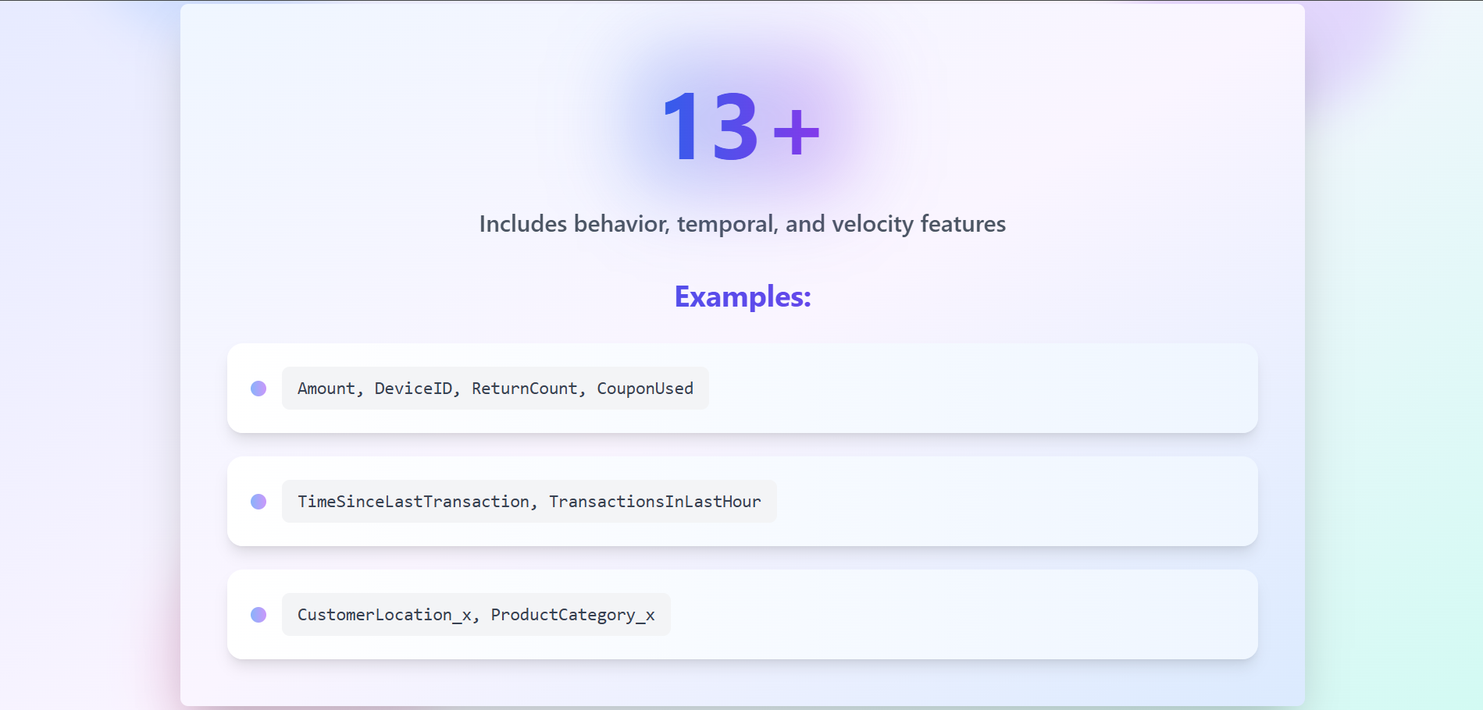
FEATURES

Slide 8

Technologies Used :

Slide 9
❌ Drawbacks :
1.Data Bias: Accuracy depends on data quality and balance.
2.Outdated Patterns: Needs regular updates to handle evolving fraud tactics.
3.Limited Features: Doesn’t use advanced signals like IP, payment method, or user history.
4.Security Risks: User data handling needs encryption and authentication.
5.Fixed Threshold: Static 0.5 cutoff may cause misclassifications.

Slide 10
Thank you

